Slide 1
Semantic Analysis

Slide 2
Semantic Analysis
Semantic Analyzer
Attribute Grammars
Top-Down Translators
Bottom-Up Translators
Recursive Evaluators
Type Checking

Slide 3
Semantic Analysis in Compiler Design
Third phase of compiler Design.
Makes sure that declarations and statements are semantically correct.
Collection of procedures called by the parser as and when required by the grammar.
Syntax tree and symbol table are used to check the consistency of the given code.
Information is subsequently used by the compiler during the intermediate code generation.

Slide 4
Semantic Errors:
1. Type mismatch.
2. Undeclared variables.
3. Reserved identifier misuse.
4. Multiple declaration of a variable in a scope.
5. Accessing an out of scope variable.
6. Actual and formal parameter mismatch.

Slide 5
Functions of Semantic Analysis
Type Checking:
Ensures that data types are used in a way that is consistent with their definition.
Label checking.
A program should contain labels and references.
Flow-control check.
Keeps a check that control structures are used in a proper manner.

Slide 6
Semantic Analyzer
source
program
Lexical
Analyzer
Syntax
Analyzer
Semantic
Analyzer
correct
program
Symbol
Table

Slide 7
Semantics
Type of each construct
Interpretation of each construct
Translation of each construct

Slide 8
Attribute Grammars
An attribute grammar is a context free grammar with associated attributes and semantic rules
Each grammar symbol is associated with a set of attributes
Each production is associated with a set of semantic rules for computing attributes

Slide 9
Attribute grammars (Contd.)
Each attribute has well defined domain of values such as integer, float, character, string and expressions.
Attribute grammar can pass values or information among the nodes in a parse tree.

Slide 10
Production | Semantic Rules
L → E ‘\n’ | print(E.val)
E →E1 + T | E.val:=E1.val + T.val
E →T | E.val:=T.val
T →T1 * F | T.val:=T1.val * F.val
T →F | T.val:=F.val
F → (E) | F.val:=E.val
F →digit | F.val:=digit.val

Slide 11
Annotated Parse Trees
L
print(E.val)
Expression: 3 * 5 + 4
E.val = 19
‘\n’
E.val = 15
‘+’
T.val = 4
T.val = 15
F.val = 4
T.val = 3
‘*’
F.val = 5
digit.val = 4
F.val = 3
digit.val = 5
digit.val = 3

Slide 12
Attributes
An attribute of a node (grammar symbol) in the parse tree is synthesized if its value is computed from that of its children
An attribute of a node in the parse tree is inherited if its value is computed from that of its parent and siblings

Slide 13
Production | Semantic Rules
L → E ‘\n’ | print(E.val)
E →E1 + T | E.val:=E1.val + T.val
E →T | E.val:=T.val
T →T1 * F | T.val:=T1.val * F.val
T →F | T.val:=F.val
F → (E) | F.val:=E.val
F →digit | F.val:=digit.val

Slide 14
Synthesized Attributes
L
print(E.val)
3 * 5 + 4
E.val = 19
‘\n’
E.val = 15
‘+’
T.val = 4
T.val = 15
F.val = 4
T.val = 3
‘*’
F.val = 5
digit.val = 4
F.val = 3
digit.val = 5
digit.val = 3

Slide 15
Production | Semantic Rules
D → TL | L.in:=T.type
T → int | T.type:=integer
T → float | T.type:=float
L → L1 ‘,’ id | L1.in:=L.in addtype(id.entry, L.in)
L → id | addtype(id.entry, L.in)

Slide 16
Inherited Attributes
D
T.type = float
L.in = float
float
L.in = float
‘,’
id₃
L.in = float
‘,’
id₂
id₁

Slide 17
Two Notations
Syntax-Directed Definitions
Translation Schemes

Slide 18
Syntax-Directed Definitions
Each grammar production A → α is associated with a set of semantic rules of the form b:=f(c₁,c_{2,}…,c_{k}) where f is a function and 1. b is a synthesized attribute of A and c₁, c₂, …, c_{k} are attributes of A or grammar symbols in α,
or 2. b is an inherited attribute of one of the grammar symbols in α and c₁, c₂, …, c_{k} are attributes of A or grammar symbols in α.

Slide 19
Dependencies of Attributes
In the semantic rule b := f(c₁, c₂, …, c_{k}) we say b depends on c₁, c₂, …, c_{k}
The semantic rule for b must be evaluated after the semantic rules for c₁, c₂, …, c_{k}
The dependencies of attributes can be represented by a directed graph called dependency graph

Slide 20
Dependencies of Attributes (Contd.)
Suppose A.a:=f(X.x, Y.y) is a semantic rule for the production:
A → XY. It defines that a synthesized attribute A.a that depends on attributes X.x and Y.y. in a parse tree, there will be nodes A.a, X.x and Y.y in the dependency graph with an edge to A.a from X.x since A.a depends on X.x and an edge to A.a from Y.y since A.a also depends on Y.y.

Slide 21
Dependencies of Attributes (Contd.)
Suppose X.i:= g(A.a, Y.y) is a semantic rule for the production:
A → XY. It defines that a synthesized attribute X.i that depends on attributes A.a and Y.y. in a parse tree, there will be nodes A.a, X.i and Y.y in the dependency graph with an edge to X.i from A.a since X.i depends on A.a and an edge to X.i from Y.y since X.i also depends on Y.y.

Slide 22
Dependency Graphs
Represents the flow of information among attributes in a parse tree.
Represents evaluation order for attributes in a parse tree.
Represents how the values can be computed in an annotated parse tree.

Slide 23
Production | Semantic Rules
E → E + T | E.val:=E1.val + T.val
E →T | E.val:=T.val
T →T1 * F | T.val:=T1.val * F.val
T →F | T.val:=F.val
F →digit | F.val:=digit.val

Slide 24
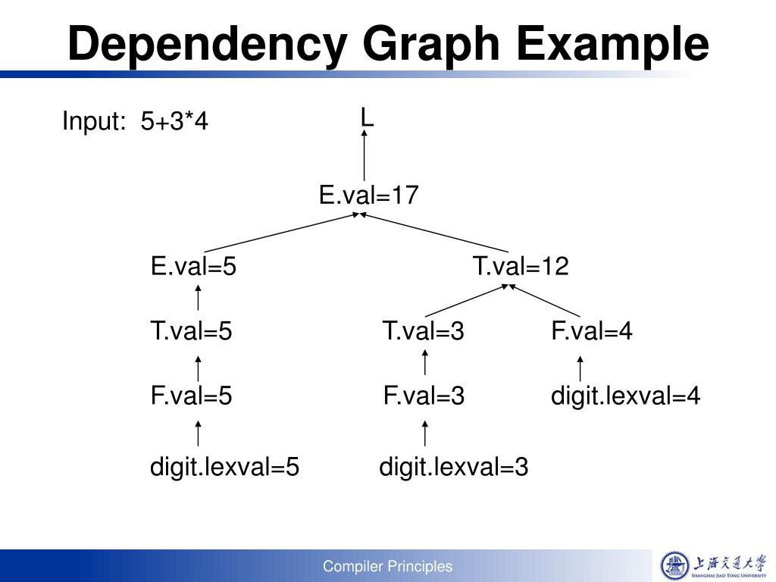

Slide 25
Dependency Graphs
D
T
1 type
in 2
L
4
float
in 5
L
7
‘,’
id₃
3 entry
in 8
L
10
‘,’
id₂
6 entry
id₁
9 entry

Slide 26
Evaluation Order
Apply topological sort on dependency graph
a1 := float
a2 := a1
addtype(a3, a2) /* a4 */
a5 := a2
addtype(a6, a5) /* a7 */
a8 := a5
addtype(a9, a8) /* a10 */
a1 := float
a2 := a1
a5 := a2
a8 := a5
addtype(a9, a8) /* a10 */
addtype(a6, a5) /* a7 */
addtype(a3, a2) /* a4 */

Slide 27
S-Attributed Definitions
A syntax-directed definition is S-attributed if it uses synthesized attributes exclusively

Slide 28
Production | Semantic Rules
L → E ‘\n’ | print(E.val)
E →E1 ‘+’ T | E.val:=E1.val + T.val
E →T | E.val:=T.val
T →T1 ‘*’ F | T.val:=T1.val * F.val
T →F | T.val:=F.val
F → ‘(‘ E ‘)’ | F.val:=E.val
F →digit | F.val:=digit.val

Slide 29
L-Attributed Definitions
A syntax-directed definition is L-attributed if each attribute in each semantic rule for each production A → X₁ X₂ … X_{n} is a synthesized attribute, or an inherited attribute of X_{j}, 1 ≤ j ≤ n, depending only on 1. the attributes of X₁, X₂, …, X_{j-1} 2. the inherited attributes of A
Every S-attributed definition is also L-attributed.

Slide 30
Production | Semantic Rules
D → TL | L.in:=T.type
T → int | T.type:=integer
T → float | T.type:= float
L → L1 ‘,’ id | L1.in:=L.in addtype(id.entry, L.in)
L → id | addtype(id.entry, L.in)

Slide 31
Production | Semantic Rules
A → LM | L.i := l(A.i) M.i:= m(L.s) A.s := f(M.s)
A → QR | R.i := r(A.i) Q.i := q(R.s) A.s := f(Q.s)
A non L-attributed Syntax directed definition

Slide 32
Translation Schemes
A translation scheme is an attribute grammar in which semantic rules are enclosed between braces { and }, and are inserted within the right sides of productions.
The value of an attribute must be available when a semantic rule refers to it.

Slide 33
An Example
D → T {L.in := T.type} L
T → int {T.type := integer}
T → float {T.type := float}
L → {L₁.in := L.in} L₁ ‘,’ id {addtype(id.entry, L.in)}
L → id {addtype(id.entry, L.in)}

Slide 34
An Example
D
T
{L.in := T.type}
L
float
{T.type := float}
{L₁.in := L.in}
L
‘,’
id₃
{addtype()}
{L₁.in := L.in}
L
‘,’
id₂
{addtype()}
id₁
{addtype()}

Slide 35
Example
Consider the expression:
S= 2 + 3 * 4
Productions | Semantic Rules
E → E+T | E.val = E.val + T.val -----(1)
E → T | E.val = T.val---------(2)
T → T *F | T.val = T.val * F.val-------(3)
T → F | T.val = F.val---------(4)
F → num | F.val = num.lexval-----(5)

Slide 36
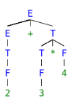
The parse tree corresponding to the above will be:

Slide 37
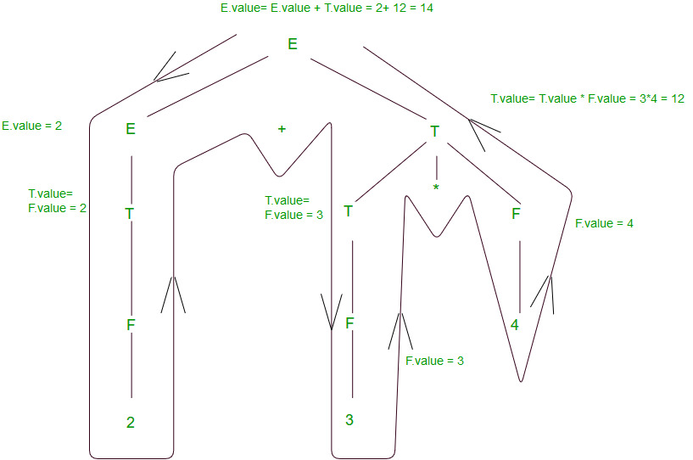

Slide 38
An Example
E → T R
T → num {print(num.val)}
R → addop T {print(addop.lexeme)} R R → ε
E
9 - 5 + 2
T
R
9 5 - 2 +
9
{print(‘9’)}
‘-’
T
{print(‘-’)}
R
5
{print(‘5’)}
‘+’
T
{print(‘+’)}
R
2
{print(‘2’)}
ε

Slide 39
Another example
Consider the string 1+2+3.
Production is: E→ E + T {print ‘+’} | T
T → num {print (num.value)}.
Removing Left recursion we have:
E → TR
R → +T {print ‘+’} | R
R →ε
T → num {print (num.value)}.

Slide 40
Parse Tree
E
T R
| + T {print ‘+’} R
num
+ T {print ‘+’} R
{print (num.value)}.
+ T num {print (num.value)} R
| | | 3
1 num {print (num.value)}. ε
|
2
Output: 12+3+

Slide 41
Restrictions on Translation Schemes
An inherited attribute for a symbol on the right side must be computed in a semantic rule before that symbol.
An action must not refer to a synthesized attribute of a symbol to its right.
A synthesized attribute for the non-terminal on the left can be computed after all attributes it depends on have been computed. The actions are generally placed on the right side of the production.

Slide 42
Construction of Syntax Trees
An abstract syntax tree is a condensed form of parse tree useful for representing constructs
if-stmt
E
if
expr
then
stmt
else
stmt
E
+
T
+
E
*
T
F
*
4
T
F
4
3
5
if-stmt
F
5
expr
stmt
stmt
3

Slide 43
Syntax Trees for Expressions
Interior nodes are operators
Leaves are identifiers or numbers
Functions for constructing nodes
mknode(op, left, right)
mkleaf(id, entry)
mkleaf(num, value)

Slide 44
Production | Operations
E → E ‘+’ T | E.ptr:= mknode(‘+’, E1.ptr, T.ptr)
E → E ‘-’ T | E.ptr:= mknode(‘-’, E1.ptr, T.ptr)
E → T | E.ptr:=T.ptr
T → ‘(‘ E ‘)’ | T.ptr:= E.ptr
T → id | T.ptr:= mkleaf(id, id.entry)
T → num | T.ptr:= mkleaf(num, num.value)

Slide 45
An Example
a - 4 + b
+
p1 := mkleaf(id, entry_{a});
p2 := mkleaf(num, 4);
p3 := mknode(‘-’, p1, p2);
p4 := mkleaf(id, entry_{b});
p5 := mknode(‘+’, p3, p4);
-
id
b
id
a
num
4

Slide 46
Another Example
Draw the syntax tree for the expression:
x * y – 5 + z
Symbol | Operation
x | p1:= mkleaf(id, entry_x)
y | p2:= mkleaf(id, entry_y)
* | p3:= mknode(‘*’, p1,p2)
5 | p4:= mkleaf (num,5)
- | p5:= mknode(‘-’, p3,p4)
z | p6:= mkleaf(id, entry_z)
+ | p7:= mknode(‘+’, p5,p6)

Slide 47
Syntax Directed Definitions (SDD)
Production | Operations
E → E1 ‘+’ T | E.ptr:= mknode(‘+’, E1.ptr, T.ptr)
E → E1 ‘-’ T | E.ptr:= mknode(‘-’, E1.ptr, T.ptr)
E → E1 ‘*’ T | E.ptr:= mknode(‘*’, E1.ptr, T.ptr)
E → T | T.ptr:= E.ptr
T → id | T.ptr:= mkleaf(id, id.entry)
T → num | T.ptr:= mkleaf(num, num.value)

Slide 48
Syntax Tree for x * y – 5 + z
p7
p5 p6
p3 p4
p1 p2
+ | p5 | p6
- | p3 | p4
id | entry_z
* | p1 | p2
num | 5
id | entry_x
id | entry_y

Slide 49
Top-Down Translators
For each nonterminal A,
inherited attributes → formal parameters
synthesized attributes → returned values
For each production,
for each terminal X with synthesized attribute x, save X.x; match(X); advance input;
for nonterminal B, c := B(b₁, b₂, …, b_{k});
for each semantic rule, copy the rule to the parser

Slide 50
An Example
E → T { R.i := T.nptr }
R { E.nptr := R.s }
R → addop
T { R₁.i := mknode(addop.lexeme, R.i, T.nptr) }
R₁ { R.s := R₁.s }
R → ε { R.s := R.i }
T → “(” E “)” { T.nptr := E.nptr }
T → num { T.nptr := mkleaf(num, num.value) }

Slide 51
An Example
syntax_tree_node *E( );
syntax_tree_node *R( syntax_tree_node * );
syntax_tree_node *T( );
syntax_tree_node *E( ) {
syntax_tree_node *enptr, *tnptr, *ri, *rs;
tnptr = T( );
ri = tnptr; /* R.i := T.nptr */
rs = R(ri);
enptr = rs; /* E.nptr := R.s */
return enptr;
}

Slide 52
An Example
syntax_tree_node *R(syntax_tree_node * i) {
syntax_tree_node *nptr, *i1, *s1, *s;
char addoplexeme;
if (lookahead == addop) {
addoplexeme = lexval;
match(addop);
nptr = T();
i1 = mknode(addoplexeme, i, nptr);
/* R₁.i := mknode(addop.lexeme, R.i, T.nptr) */
s1 = R(i1);
s = s1; /* R.s := R₁.s */
} else s = i; /* R.s := R.i */
return s;
}

Slide 53
An Example
syntax_tree_node *T( ) {
syntax_tree_node *tnptr, *enptr;
int numvalue;
if (lookahead == ‘(’ ) {
match(‘(’); enptr = E( ); match(‘)’);
tnptr = enptr; /* T.nptr := E.nptr */
} else if (lookahead == num ) {
numvalue = lexval; match(num);
tnptr = mkleaf(num, numvalue);
/* T.nptr := mkleaf(num, num.value) */
} else error( );
return tnptr;
}

Slide 54
Bottom-Up Translators
Keep the values of synthesized attributes on the parser stack
A → X Y Z A.a := f(X.x, Y.y, Z.z);
symbol
val
...
...
X
X.x
val[top-2]
Y
Y.y
val[top-1]
top
Z
Z.z
val[top]
A → X Y Z val[ntop] := f(val[top-2], val[top-1], val[top]);

Slide 55
Evaluation of Synthesized Attributes
When a token is shifted onto the stack, its attribute value is placed in val[top]
Code for semantic rules are executed just before a reduction takes place
If the left-hand side symbol has a synthesized attribute, code for semantic rules will place the value of the attribute in val[ntop]

Slide 57
An Example
Input symbol val production used
3*5+4n
*5+4n digit 3
*5+4n F 3 F → digit
*5+4n T 3 T → F
5+4n T * 3 _
+4n T * digit 3 _ 5
+4n T * F 3 _ 5 F → digit
+4n T 15 T → T * F
+4n E 15 E → T

Slide 58
An Example
Input symbol val production used
+4n E 15 E → T
4n E + 15 _
n E + digit 15 _ 4
n E + F 15 _ 4 F → digit
n E + T 15 _ 4 T → F
n E 19 E → E + T
E n 19 _
L _ L → E n

Slide 59
Evaluation of Inherited Attributes
Removing embedding actions from translation scheme by introducing marker nonterminals
E → T R
R → “+” T {print(‘+’)} R | “-” T {print(‘-’)} R | ε
T → num {print(num.val)}
E → T R
R → “+” T M R | “-” T N R | ε
T → num {print(num.val)}
M → ε {print(‘+’)}
N → ε {print(‘-’)}

Slide 60
Evaluation of Inherited Attributes
Inheriting synthesized attributes on the stack A → X {Y.i := X.s} Y
symbol
val
...
...
X
X.s
top
Y

Slide 61
An Example
D → T {L.in := T.type}
L
T → int {T.type := integer}
T → float {T.type := float}
L → {L₁.in := L.in}
L₁ ‘,’ id {addtype(id.entry, L.in)}
L → id {addtype(id.entry, L.in)}
D → T L
T → int {val[ntop] := integer}
T → float {val[ntop] := float}
L → L₁ ‘,’ id {addtype(val[top], val[top-3])}
L → id {addtype(val[top], val[top-1])}

Slide 62
An Example
Input symbol val production used
int p,q,r
p,q,r int _
p,q,r T i T → int
,q,r T id i e
,q,r T L i _ L → id
q,r T L , i _ _
,r T L , id i _ _ e
,r T L i _ L → L “,” id
r T L , i _ _
T L , id i _ _ e
T L i _ L → L “,” id
D

Slide 63
Evaluation of Inherited Attributes
Simulating the evaluation of inherited attributes Inheriting the value of a synthesized attribute works only if the grammar allows the position of the attribute value to be predicted

Slide 64
An Example
S → a A C {C.i := A.s}
S → b A B C {C.i := A.s}
C → c {C.s := g(C.i)}
S → a A C {C.i := A.s}
S → b A B M C {M.i := A.s; C.i := M.s}
C → c {C.s := g(C.i)}
M → ε {M.s := M.i}

Slide 65
Another Example
S → a A C {C.i := f(A.s)}
S → a A N C {N.i := A.s; C.i := N.s}
N → ε {N.s := f(N.i)}

Slide 66
From Inherited to Synthesized
D → L “:” T
L → L “,” id | id
T → integer | char
D → id L
L → “,” id L | “:” T
T → integer | char
D
D
L
:
T
id
L
,
,
id
L
L
id
int
,
,
id
L
L
id
:
T
id
int

Slide 67
Bison
%token DIGIT
%%
line : expr ‘\n’ {printf(“%d\n”, $1);}
;
expr: expr ‘+’ term {$$ = $1 + $3;}
| term
;
term: term ‘*’ factor {$$ = $1 * $3;}
| factor
;
factor: ‘(’ expr ‘)’ {$$ = $2;}
| DIGIT
;

Slide 68
Bison
%union {
char op_type; int value;
}
%token <value> DIGIT
%type <op_type> op
%type <value> expr factor
%%
expr: expr op factor {$$ = $2 == ‘+’ ? $1 + $3 : $1 - $3;}
| factor
;
op: + {$$ = ‘+’;}
| - {$$ = ‘-’;}
;
factor: DIGIT ;

Slide 69
Recursive Evaluators
The parser constructs a parse tree explicitly
A recursive evaluator is a function that traverses the parse tree and evaluates attributes
A recursive evaluator can traverse the parse tree in any order
A recursive evaluator can traverse the parse tree multiple times

Slide 70
An Example
S → { B.ps := 10 }
B { S.ht := B.ht }
B → { B₁.ps := B.ps }
B₁ { B₂.ps := B.ps }
B₂ { B.ht := max(B₁.ht, B₂.ht) }
B → { B₁.ps := B.ps }
B₁
sub { B₂.ps := shrink(B.ps) }
B₂ { B.ht := disp(B₁.ht, B₂.ht) }
B → text { B.ht := text.h × B.ps }

Slide 71
An Example
S
ht
ps B ht
ps
B
ht
ps
B
ht
ps B₁ ht
ps B₂ ht
text
h

Slide 72
An Example
function B(n, ps);
var ps1, ps2, ht1, ht2;
begin
case production at node n of
‘B → B₁ B₂’:
ps1 := ps; ht1 := B(child(n, 1), ps1); ps2 := ps;
ht2 := B(child(n, 2), ps2); return max(ht1, ht2);
‘B → B₁ sub B₂’:
ps1 := ps; ht1 := B(child(n, 1), ps1); ps2 := shrink(ps);
ht2 := B(child(n, 3), ps2); return disp(ht1, ht2);
‘B → text’:
return ps × text.h;
default: error end
end;

Slide 74
An Example
i A s
i A s
i L s
i M s
i Q s
i R s

Slide 75
An Example
function A(n, ai);
var li, ls, mi, ms, ri, rs, qi, qs;
begin
case production at node n of
‘A → L M’:
li := l(ai); ls := L(child(n, 1), li); mi := m(ls);
ms := M(child(n, 2), mi); return f(ms);
‘A → Q R’:
ri := r(ai); rs := R(child(n, 2), ri); qi := q(rs);
qs := Q(child(n, 1), qi); return f(qs);
default: error
end
end;

Slide 77
An Example
S
r
S
r
i
E
s
t
i
E
s
t
i
E
s
t
i
E₁
s
t
i
E2
s
t
i
E
s
t
i
E
s
t
i
E
s
t
id
s
id
s
id
s

Slide 78
An Example
function Es(n);
var s1, s2;
begin
case production at node n of
‘E → E₁ E₂’:
s1 := Es(child(n, 1)); s2 := Es(child(n, 2));
return fs(s1, s2);
‘E → id’:
return id.s;
default: error
end
end;

Slide 79
An Example
function Et(n, i);
var i1, t1, i2, t2;
begin
case production at node n of
‘E → E₁ E₂’:
i1 := fi1(i); t1 := Et(child(n, 1), i1);
i2 := fi2(i); t2 := Et(child(n, 2), i2);
return ft(t1, t2);
‘E → id’:
return h(i);
default: error
end
end;

Slide 80
An Example
function Sr(n);
var s, i, t;
begin
s := Es(child(n, 1));
i := g(s);
t := Et(child(n, 1), i);
return t
end;

Slide 81
Type Systems
A type system is a collection of rules for assigning types to the various parts of a program
A type checker implements a type system
Types are represented by type expressions

Slide 82
Type Expressions
A basic type is a type expression
boolean, char, integer, real, void, type_error
A type constructor applied to type expressions is a type expression
array: array(I, T)
product: T₁ × T₂
record: record((N₁ × T₁) × (N₂ × T₂))
pointer: pointer(T)
function: D → R

Slide 83
Type Declarations
P → D “;” E D → D “;” D | id “:” T { addtype(id.entry, T.type) } T → char { T.type := char } T → integer { T.type := integer } T → “*” T₁ {T.type := pointer(T₁.type) } T → array “[” num “]” of T₁ { T.type := array(num.value, T₁.type) }

Slide 84
Type Checking of Expressions
E → literal {E.type := char}
E → num {E.type := int}
E → id {E.type := lookup(id.entry)}
E → E₁ mod E₂
{E.type := if E₁.type = int and E₂.type = int
then int else type_error}
E → E₁ “[” E₂ “]”
{E.type := if E₁.type = array(s, t) and E₂.type = int
then t else type_error}
E → “*” E₁
{E.type := if E₁.type = pointer(t) then t else type_error}

Slide 85
Type Checking of Statements
P → D “;” S
S → id “:=” E
{S.type := if lookup(id.entry) = E.type
then void else type_error}
S → if E then S₁
{S.type := if E.type = boolean
then S₁.type else type_error}
S → while E do S₁
{S.type := if E.type = boolean
then S₁.type else type_error}
S → S₁ “;” S₂
{S.type := if S₁.type = void and S₂.type = void
then void else type_error}

Slide 86
Type Checking of Functions
T → T₁ “→” T₂
{T.type := T₁.type → T₂ .type}
E → E₁ “(” E₂ “)”
{E.type := if E₁.type = s → t and E₂.type = s
then t else type_error}

